Slide 1


Slide 2
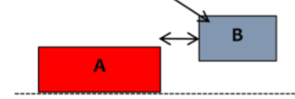
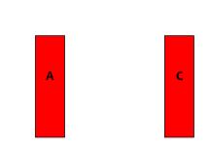
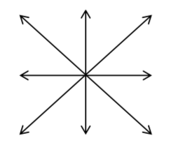
LANGUAGE_POSITIONS
Cạnh: A is near, next to, adjacent to B
Đối diện: A is opposite, facing, parallel to C
Directions:
A
North(-)west
North
B
North(-)east
B is to the Southeast of A
West
East
A
B
South(-)west
South(-)east
B is in the Southeast of A
South
Notes:
B is to the Southeastern area of A

Slide 3
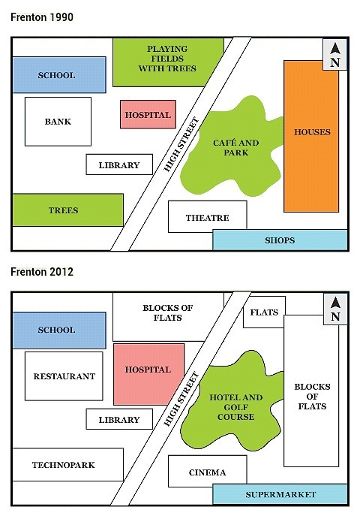
MAPS – SẮP XẾP THÔNG TIN THÂN BÀI
Chia theo khu vực
(chia được khu vực riêng biệt, có đường/bờ sông cắt ngang)
Body 1: describe the locations + changes of the venues on one side.
Body 2: describe the locations + changes of the other.
Notes:
Principles: Các sự thay đổi giống nhau (hoàn toàn), gộp vào để miêu tả - chia 2 bodies đều.

Slide 4
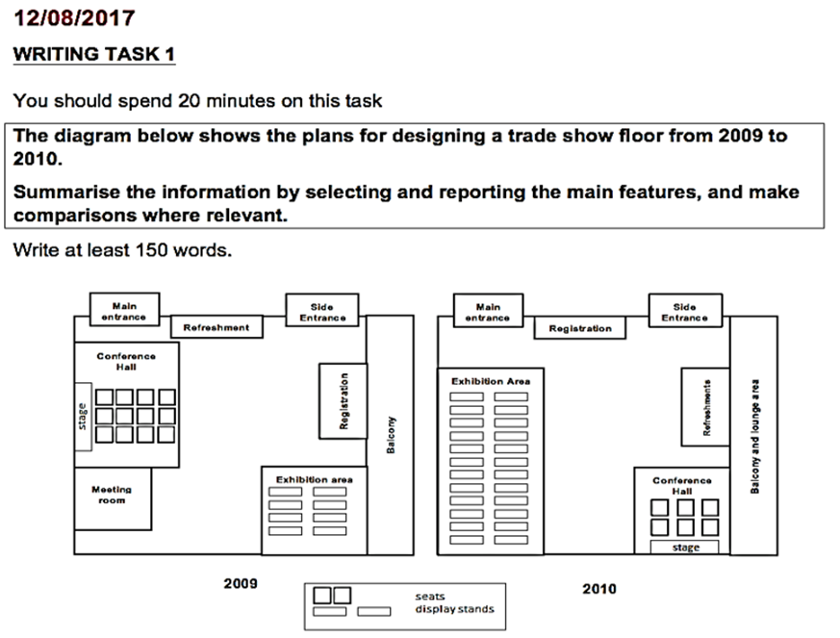
MAPS – SẮP XẾP THÔNG TIN THÂN BÀI
Chia theo sự thay đổi
(nhóm các địa điểm có sự thay đổi giống nhau)
Body 1: describe the relocation of facilities ( refreshment + registration – conference hall + exhibition area)
Body 2: describe the other areas.

Slide 5
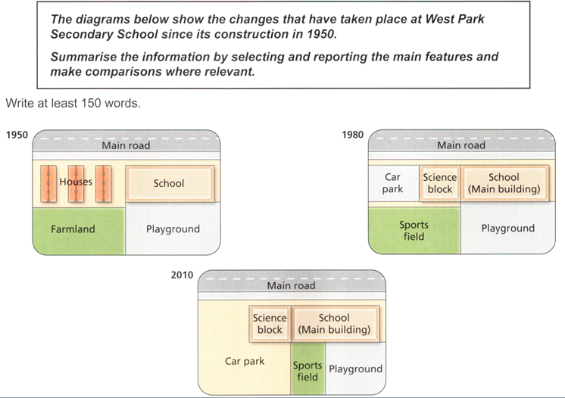
MAPS – SẮP XẾP THÔNG TIN THÂN BÀI
Chia theo năm
(không phân được vùng + các địa điểm thay đổi 2-3 lần)
Body 1: describe the 1st map – location.
Body 2: describe the 2nd map – changes.
Body 3: describe the 3rd map – changes.

Slide 6
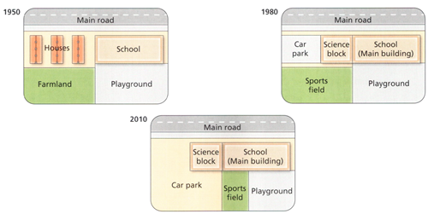
Cách miêu tả:
What – cái gì
Where – ở đâu
How – thay đổi ntn
Why – để làm gì (optional – linh hoạt)
e.g: Secondary school - constructed - near the main road & close to some houses
In 1950, [construction]
S1: What [A] be constructed + where [compared with the map & another location - B]
S2: There be what [C] + where [compared with A/B]
S3: Where [vs A/B/C] be what [D]
Notes:
Nhìn vào phần đỏ trước – có mấy cấu trúc là gì, sau đó đưa địa điểm vào, miêu tả từ điểm này sang điểm khác & đa dạng cấu trúc

Slide 7
In 1950, a secondary school was constructed near the main road and close to several houses. Behind the lodging area was a piece of farmland, adjacent to which there was a playground at the back of the school.

Slide 8
Cách miêu tả:
What – cái gì
Where – ở đâu
How – thay đổi ntn
Why – để làm gì (optional – linh hoạt)
e.g: houses => a car park and a science block (part of the school)
In 1980, [replacement]
S1: What [B] be turned into | converted into + something else [E]
S2: Something else [F] + be built to replace what [C]
Or
What [B] no longer exist(ed) + to build | make way for [E]
Notes:
In addition, a sports field was constructed in the place of the farmland to allow students to engage in physical activities | the farmland no longer existed to make way for …

Slide 9
Cách miêu tả:
What – cái gì
Where – ở đâu
How – thay đổi ntn
Why – để làm gì (optional – linh hoạt)
e.g: houses – turned into a car park and a science block (part of the school)
By 1980, the housing area had been torn down in an attempt to make way for the car park and a science block, with the latter being an additional school building. The school had also obtained the farmland and converted it into a sports field.
Notes:
In addition, a sports field was constructed in the place of the farmland to allow students to engage in physical activities | the farmland no longer existed to make way for …

Slide 10
Cách miêu tả:
What – cái gì
Where – ở đâu
How – thay đổi ntn
Why – để làm gì (optional – linh hoạt)
e.g: car park – expanded => sports field and playground – shrank
In 2010, [other changes]
[What] be [how] + where.
or
The area | map witness(ed) the N [how] of [what]
The year … witness(ed) the N [how] of [what]
***tips: group similar changes + , with + S + V_ing.

Slide 11
Cách miêu tả:
What – cái gì
Where – ở đâu
How – thay đổi ntn
Why – để làm gì (optional – linh hoạt)
e.g: car park – expanded => sports field and playground – shrank
The year 2010 witnessed the resizing of several venues, with the expansion of the car park, which led to the shrinkage of the sports field and the playground. Meanwhile, the school and its science building remained in the same positions.

Slide 12
Chia theo sự thay đổi
Body 1: relocation.
S1: miêu tả locations (1)
S2: miêu tả relocation (1)
S3 & 4: miêu tả locations & relocation (2).
Body 2: other changes.
S1 trở đi: miêu tả changes & locations (3) (4).
Cách miêu tả:
What – cái gì
Where – ở đâu
How – thay đổi ntn
Why – để làm gì (optional)
Notes:
Nhóm các địa điểm thay đổi giống nhau rồi cùng miêu tả - ở đầu bài thì miêu tả vị trí => sự thay đổi

Slide 13
Body 1: relocation.
S1: miêu tả locations (1)
What [A] be constructed + where [compared with the map & another location - B]
There be what [C] + where [compared with A/B]
S2: miêu tả relocation (1)
[What] be [how]
the refreshment - the registration booth
S3 & 4: m tả locations & relocation (2).
[What] be [how] + where
Conference hall & exhibition area
Seating
Notes:
B is to the Southeastern area of A

Slide 14
Body 1: full body
In 2009, a refreshment area was housed in the North of the show and between two entrances. There was also a registration in the East of the room, attached to the Balcony. After 1 year, while the two entrances did not experience any change, the refreshment and the registration booth swapped their locations. Similarly, the exhibition area at the bottom right corner of the floor interchanged places with the conference hall to its Northwest, with the former expanding and the latter shrinking. In terms of seating, the exhibition area added more display stands, while visitors to the hall made use of seats to access the stage
Notes:
Câu cuối đổi subject

